Slide 1
Glucose Detection using Nanosensor Team May1721
Members: Shir Linn Tan, Dalton Strauser, XiongSheng Yi, Wai Hang Kong
Lecturer: Professor Long Que
Subject: EE49I

Slide 2
Project Statement
To develop a disposable nanosensor that can accurately and effectively detect various concentrations of glucose in a fluid
Purposes/Goals
Developing a disposable nanosensor which can detect glucose efficiently (low cost and easy to fabricate)
Determine the upper limit and lower limit of nanosensor by using glucose with various concentration
Design the fabrication process for a nanosensor which allows continuous monitoring of glucose levels

Slide 3
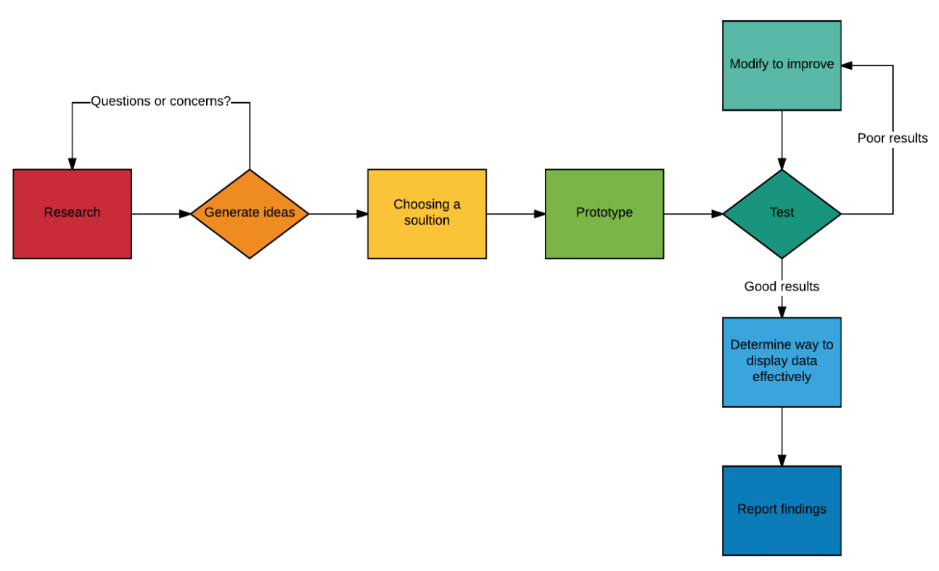
Process Flow

Slide 4
Project Timeline
Semester 1
Review multiple methods for detecting glucose using a nanosensor
Choose a method which best fits our requirements
Easy to fabricate
Easy to test
Able to produce consistent results
Design the fabrication process for the biosensor
Plan for semester 2
Fabricate the prototype
Conduct tests with prototype
Modify the device or testing method accordingly
Develop final product
Report on findings

Slide 5
Review: Different nanosensors
1. Enzyme-Coated Carbon Nanotubes as Single Molecule Biosensors
Published by K.Besteman, J.Lee, F. Wiertz et.al (April 2003)
2. Nanostructured optical microchips for cancer biomarker detection
Published by Long Que, T.Zhang, Y.He and J.Wei (October 2012)
3. Characterization of Field Effect Transistor Biosensors Fabricated Using Layer-by-Layer Nanoassembly Process
Published by Long Que and Pushparaj Pathak (2015)

Slide 6
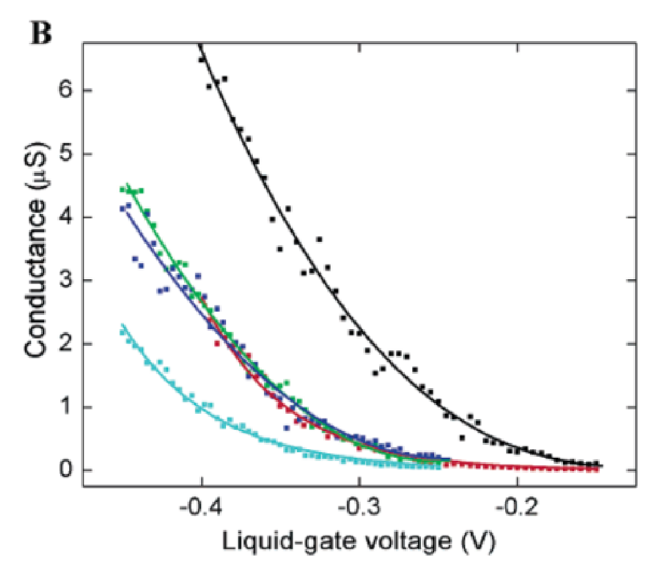
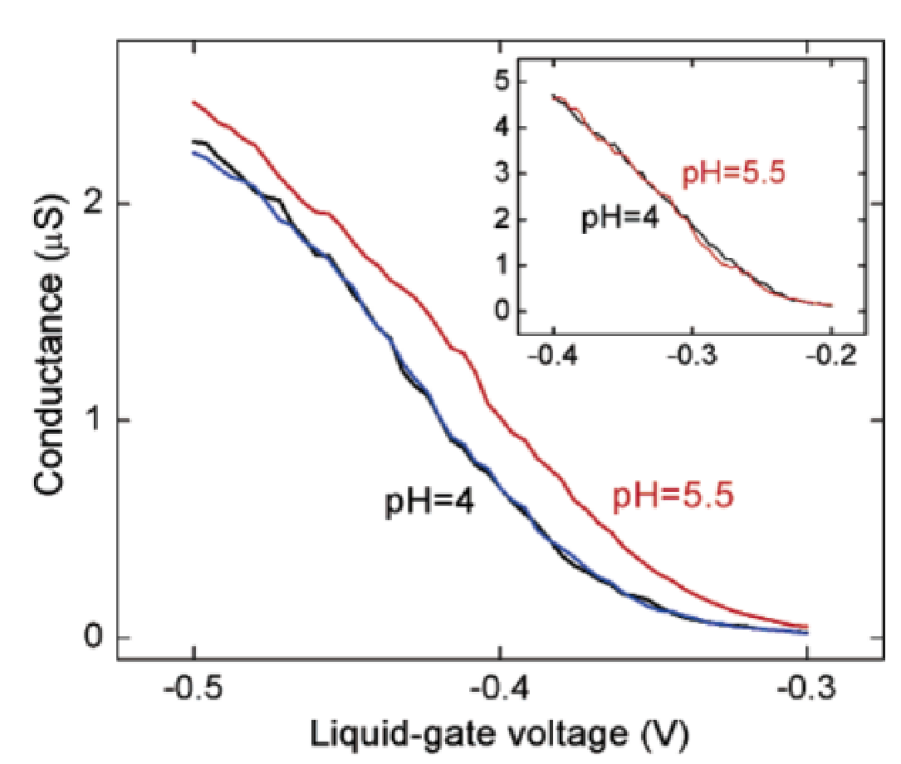
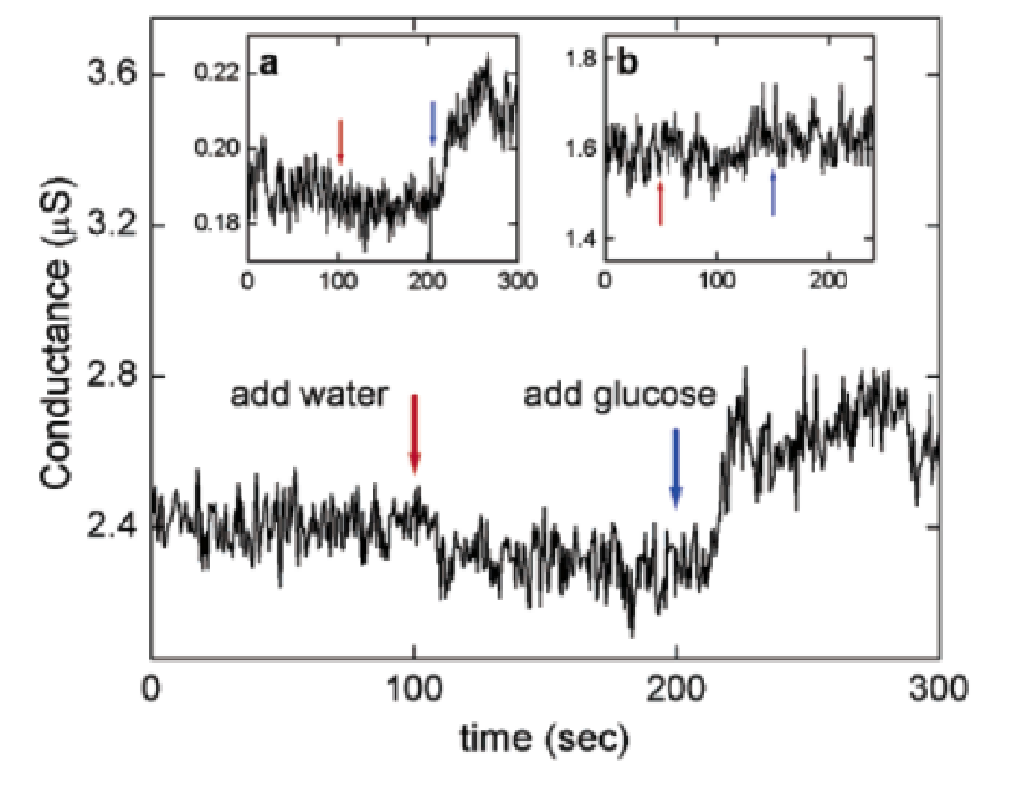
Single Wall Carbon Nanotube (SWNT)
SWNTs can be developed into biosensors
Glucose Oxidase enzyme(GOx) catalyzes the oxidation of glucose to D-glucono-δ-lactone
Controlled immobilization of GOx on sidewall – decrease conductance
GOx-coated SWNTs act as reversible pH sensors
Conductance increases when glucose is added
Immobilization vs Conductance Immobilization vs pH Conductance and Glucose
Notes:
Conductance decreases with GOx immobilisation because of capacitance change

Slide 7
Glucose Oxidase
The reaction process of GOx
GOx enzyme is an oxidoreductase
Catalyzes electron transfer from one molecule to another
Glucose is oxidized - loss of electrons
Electron transference changes conductivity
GOx has a different charge state after reaction
Change in conductivity can be measured
Notes:
D-glucono-δ-lactone = Glucono delta-lactone
First paper is not entirely sure what exactly causes the increase in conductance, it says further tests are necessary to isolate cause. But it is not just a change in the pH

Slide 8
Findings of SWNT report
Laser-ablated and CVD-grown tubes allow proper immobilisation of GOx
Demonstrates ability to create a nanosensor from a single nanotube
Easily measurable changes in conductance
Limitations
Complicated fabrication process
Difficult to create consistent SWNTs
No uniform surface oxide after performing oxidation process

Slide 9
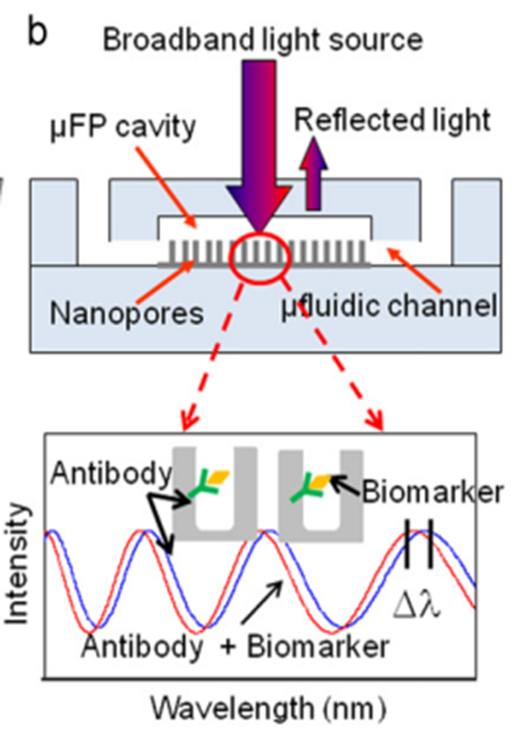
Optical Detection of Specific Antigen
Label-free detection of a cancer biomarker using Fabry–Perot interferometer (FPI) microchips
Detected the prostate cancer biomarker free prostate-specific antigen (f-PSA) with a mouse monoclonal antibody (mAb)
How does the device work?
Binding of antibody and biomarker will change the effective refractive index inside the channel
Causes a measurable change in wavelength of reflected light
Resulting data can be used to determine f-PSA concentration
Notes:
the fringes of the reflected signals will shift due to the change of the effective refractive index inside the cavity

Slide 10
Benefits and Limitations
Advantages:
Arrayed microchips can be batch fabricated inexpensively
Fluorescent dyes not needed
Biomolecules undisturbed by testing
Difficulties:
May be unsuitable for glucose detection
Notes:
Other forms of spectroscopy need fluorescent dyes, but not this example for detection of f-PSA

Slide 11
FET Biosensor
Exploited the semiconducting nature of CNT to design a label-free ﬁeld effect transistor (FET) based immunosensor
Method of fabrication:
Assembled with combination of photolithography and electrostatic layer-by-layer self-assembly(LbL)
(a) Type 1: three electrodes: source, drain, and gate --- exhibited a FET-like behavior
(b) Type 2: two electrodes: source and drain --- used to detect the biomolecules
Due to the FET, the drain current is modulated upon the binding of biomolecules with CNTF channel.

Slide 12
Findings of CNTF FET Biosensor
Advantages
More uniform device
Less variation compared to single CNT
Easier to integrate as sensor
Cheaper to fabricate than SWNT
Limitations
Uncertain whether detection capability will work for glucose

Slide 13
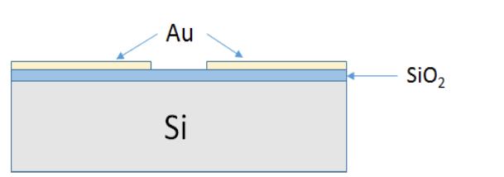
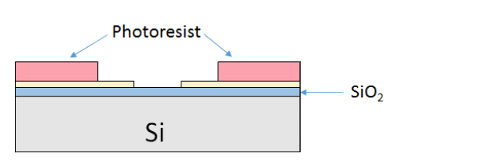
Fabrication process for our project
Combination of photolithography and electrostatic layer-by-layer self-assembly (LbL)
Fabricate Au electrodes
Thermally grown SiO2
Pattern Au electrodes for source/drain
Fabricate mold for CNTF channel
Pattern well for CNTF channel

Slide 14
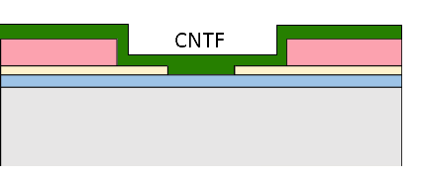
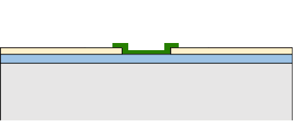
Fabrication process
Layer by layer assembly of CNTF channel
CNTF created via additive processing
Solutions of carbon nanotubes
Annealing removes water molecules and improves tunneling effects
Acetone bath lift-off
Isolates CNTF to channel only

Slide 15
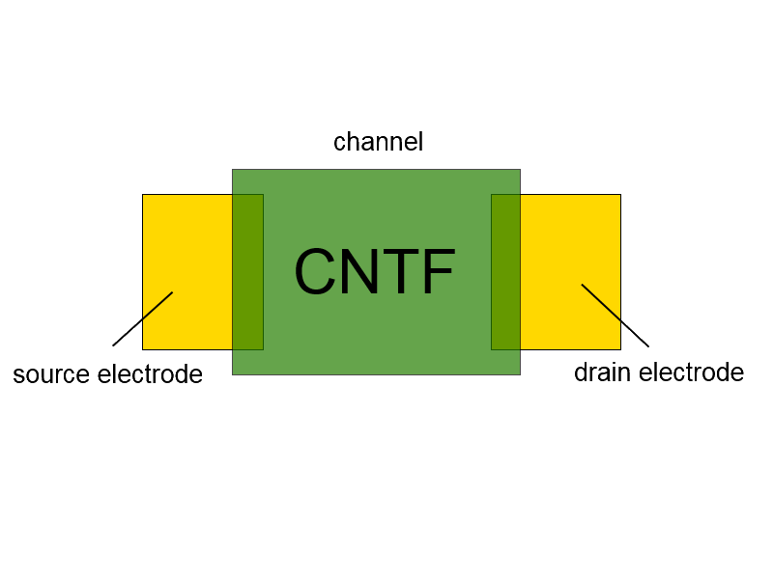
Testing methodology
Behaves like FET
Threshold voltage ~V=0
Better for low power devices
Requires attention to reference current
Drain current changes because of biomolecule interactions in channel
Binding equivalent to applying negative voltage on channel

Slide 16
Plan for the next semester
Fabricate the prototype
Conduct tests on the prototype
Modify the device or testing method accordingly
Report on findings

Slide 17
References
K. Besteman, et al., “Enzyme-Coated Carbon Nanotubes as Single-Molecule Biosensors,” Nano Letters, vol. 3, no. 6, 727-730, Mar. 2003.
T. Zhang et al, “Nanostructured optical microchips for cancer biomarker detection,” Biosensors and Bioelectronics, vol. 38, no. 1, 382-388, Oct. 2012.
P. Pathank and L. Que, “Characterization of field effect transistor biosensors fabricated using layer-by-layer nanoassembly process,” Journal of Nanoscience and Nanotechnology, vol. 15, no. 12, 9689-9692, 2015.

Slide 18
Thank You!!

