Slide 1
Glucose Detection using Nanosensor Team May1721
Members: Shir Linn Tan, Dalton Strauser, XiongSheng Yi, Wai Han Kong
Lecturer: Professor Long Que
Subject: EE492

Slide 2
Project Statement
Develop a disposable glucose nanosensor and develop a testing method to detect a range of concentrations
Goal / Purposes
Develop a low cost and easy to fabricate nanosensor
Design an effective fabrication process for the nanosensor

Slide 3
Fabrication Process
Step 1
Start with Fisherfinest Premium Clipped Corner microscope slide
Thoroughly clean and blow dry with nitrogen gas
-- remove any contaminates which can inhibit fabrication
Deposit 20nm of titanium on the glass using electron beam physical vapor deposition(EBPVD)
EBPVD:
One of the physical vapor deposition (PVD) techniques
Source material is heated by an intense beam of electrons
Molecules evaporate and travel through a vacuum chamber
Target surface is coated with these molecules until desired thickness is achieved
Microscope slide (75x25x25mm)
Step 2
Titanium (20nm)

Slide 4
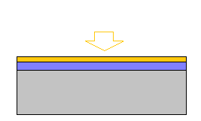
Fabrication Process
Step 3
3. Deposit 2nm of aluminum using EBPV
-aluminum adheres better to Ti
4. Submerge in acidic solution to anodize
-sulfuric acid with glycol
-AAO (Anodic Aluminum Oxide)
Aluminum (2nm)
Step 4
Acidic
solution

Slide 5
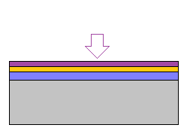
Fabrication Process
Step 5
5. Use sputtering process to deposit a thin layer of gold
-we will perform our glucose testing directly on this surface
Sputtering :
Create a gaseous plasma and accelerate the ions into the source material
Source is eroded by the incident ions
Atoms are ejected from the source due to cascading energy transfers
Ejected atoms are deposited onto the target and bind forming a thin layer
Gold (10nm)

Slide 6
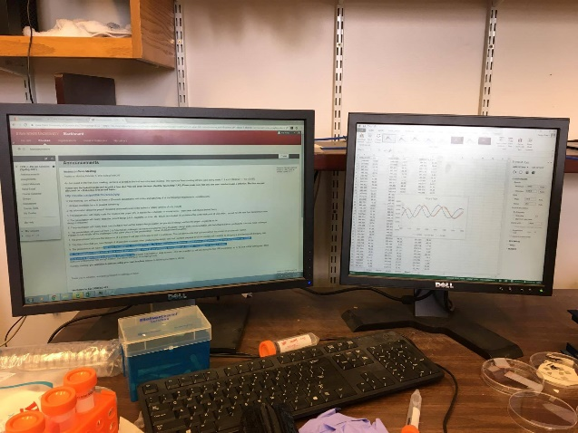
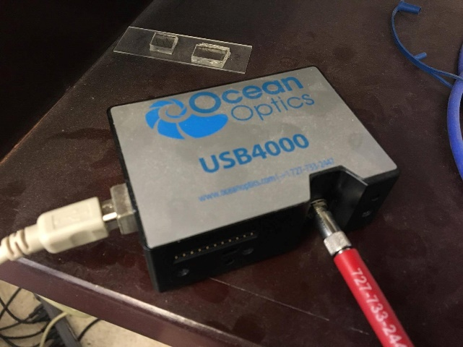
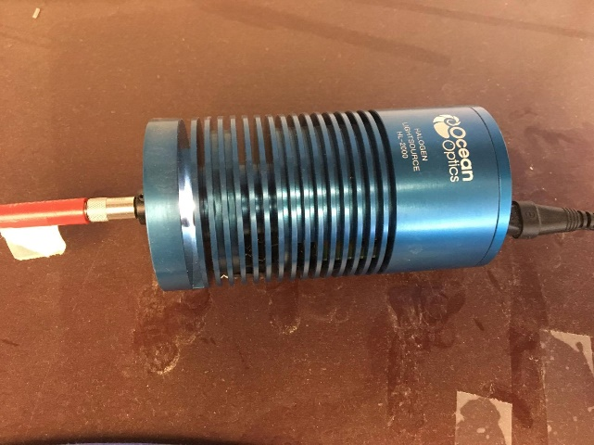
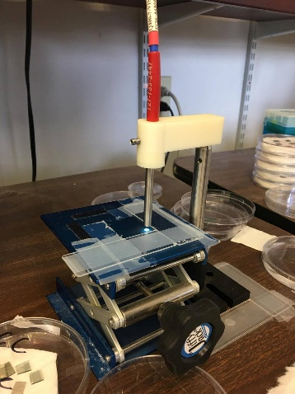
System
Computer
Spectrometer
Light source
Dual screen computer:
OceanView Spectroscopy Software
Record collected data and transfer to Microsoft Excel
Fiber Optic Fluorescence Spectrometer:
Capable of fluorescence measurements (360 – 1000nm)
Ocean Optics HL-2000: Source of light
Fiber probe: Transfers light and acts as our detector
Stage: Area to align AAO and measure the reflected wavelength
Fiber probe & Stage

Slide 7
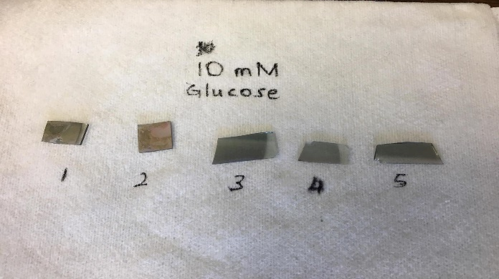
Testing
Measure the AAO (anodic aluminum oxide) without any glucose solution
Obtain a wavelength versus intensity graph using OceanView
Deposit a fixed amount of glucose solution (5ml) onto every AAO sample using a precision pipette
Place the AAO on a hot plate of 80 ºC to speed up the evaporation process
After complete evaporation, the AAO is placed under the fiber probe to obtain the wavelength-intensity graph
Repeat step 3 to 5 for two more times with exactly the same amount of glucose solution (5ml)

Slide 8
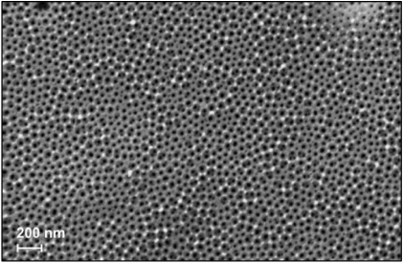
Methodology
The process of creating AAO- metal can utilize an inexpensive and simple method of electrochemical metal deposition
The AAO membrane – AAO self-organizes into a honeycomb like structure. This structure is high in density and uniform which is ideal for creating a reproducible experiment. The pores have a diameter of around 80nm. The diameter is controllable by the oxidation process. This nanostructure is great because it allows us to have a tight design parameter without needing to use a complicated process of photolithography and etching which can have high margins of error.
This electrochemically obtained porous layer of AAO is used as a sensor to detect glucose optically
SEM Image of AAO Coating Obtained in Acidic Solution

Slide 9
Figure A shows the nanopore structure before any glucose is deposited.
Figure B shows the nanopore structure with small amount of glucose deposited.
Figure C shows the nanopore with high concentration of glucose.

Slide 10
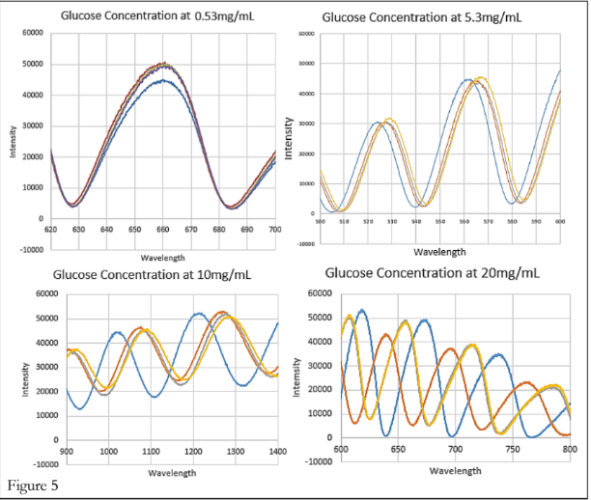
Results of Different Glucose Concentrations
Below are the shifts in wavelength by combining all data sets from a single AAO sample at different applied concentrations of glucose.
Our AAO samples were able to detect glucose concentrations from a range of 0.53mg/mL to 20mg/mL with observable wavelength shifts.

Slide 11
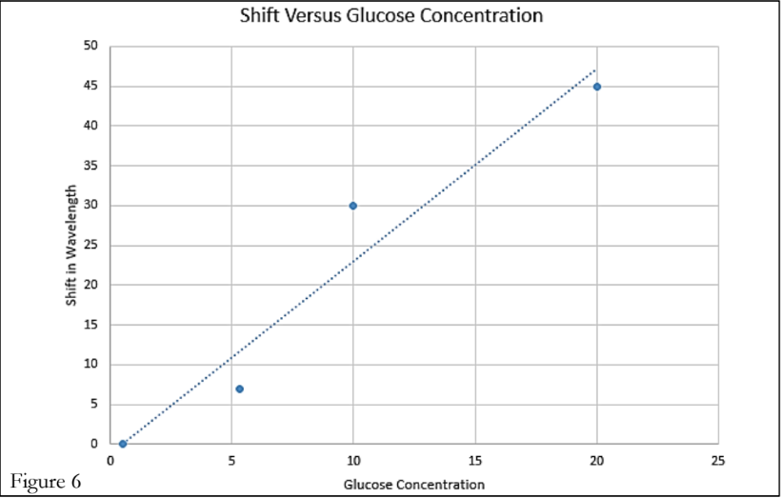
Shift of Wavelength vs Glucose Concentration
The figure above demonstrated that the shift of wavelength in terms of glucose concentration is in a linear relationship. This allows wavelength data to be translated into a specific concentration of glucose.

Slide 12
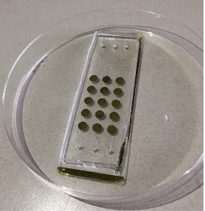
Complete version of glucose detection sensor

Slide 13
Conclusion
Success in clearing the criteria of the project.
The chips are disposable and our design is simple and easy to reproduce.
Our chip is not ready for commercial use, but our data shows promise in the possibilities.
The mean normal blood glucose level for humans is about 1mg/mL, which we were able to detect small changes at though we believe the sensor is not accurate enough on the low end to be used reliably for human blood sugar measuring.
Animals have wildly different glucose concentrations so it is possible that our sensor could be useful for application involving them instead.

Slide 14
References
(1) K. Besteman et al, “Enzyme-coated carbon nanotubes as single-molecule biosensors,” Nano Letters, vol. 3, no. 6, 727-730, Mar. 2003.
(2) T. Zhang et al, “Nanostructured optical microchips for cancer biomarker detection,” Biosensors and Bioelectronics, vol. 38, no. 1, 382-388, Oct. 2012.
(3) P. Pathank and L. Que, “Characterization of field effect transistor biosensors fabricated using layer-by- layer nanoassembly process,” Journal of Nanoscience and Nanotechnology, vol. 15, no. 12, 9689-9692, 2015.

